Slide 1

MSDS 670 Data Visualization Final Project
Kaytie Moyer
Regis University

Slide 2
Table of Contents
Research Question
Methodology
Results
Top 13 Countries of Content Release
Netflix Content Release from 2008 to 2022
The Type of Content Released from 2008 to 2022
The Most Productive Years of Netflix
Content Ratings
The Thirty Most Popular Netflix Content Categories
Conclusion
References

Slide 3
Research Question
Is Netflix releasing more content in some countries then others? Does Netflix focus on releasing movies or TV shows? Has there been a year between 2008 and 2022 where Netflix has released more content?

Slide 4
Methodology
Available Netflix data (found on public domains) was collected and stored in a csv file. This file is updated by the collecting analyst, Shivam Bansal, every thirty days.
The link to the original csv file used for this analysis can be found in the reference section of this presentation.
Netflix collects and stores data on the content they release, including the directors, categories, types of content, ratings, locations released, and year the content was released. This is all available as public domain data and can be viewed on both the application and the website belonging to Netflix.

Slide 5
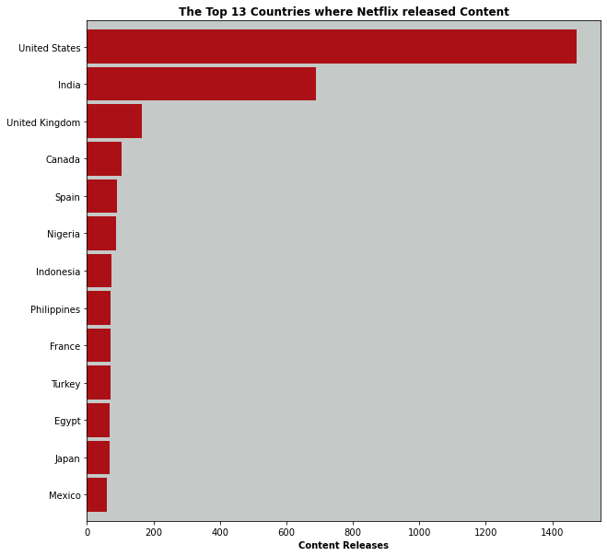
The Top 13 Countries where Netflix released Content
Netflix released more content in the United States then any other country.
India, with only half the content of the United States, still released over 100% more content than the other eleven countries included in the analysis.
Three out of four of the top countries were primarily English speaking countries.

Slide 6
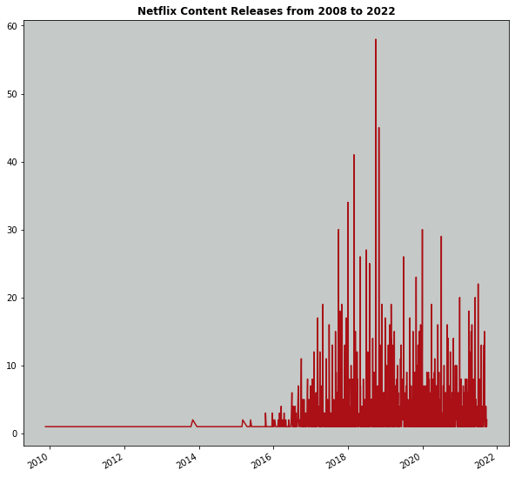
Netflix Content Releases from 2008 to 2022
Netflix had the highest spike of content release around 2019.
Before 2016, Netflix released very little to no content of its own.
Content release sharply declined after 2019, with smaller spikes of increased releases in 2020.
Content release has remained primarily steady during 2021.

Slide 7
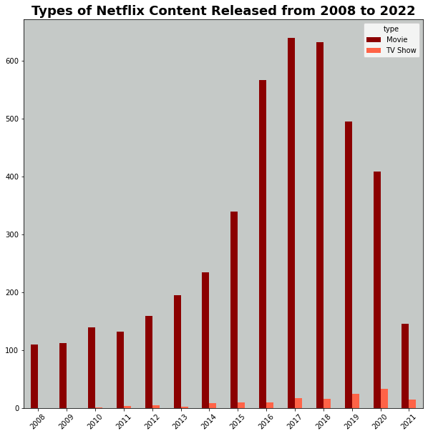
Types of Netflix Content Released from 2008 to 2022
Netflix has focused on movies over 300% more than television shows.
The highest television show content release was in 2020, while the highest movie content release was in 2017, closely followed by 2018.
Movie releases sharply decreased by about 125% during 2021, with television show releases decreasing by 100%.

Slide 8
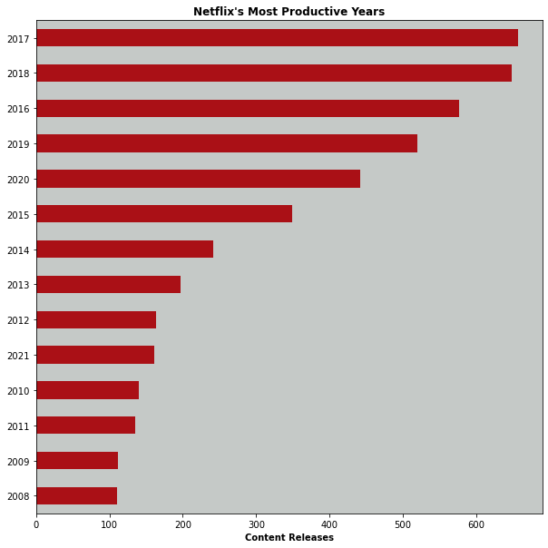
Netflix’s Most Productive Years
Netflix had the highest productivity, measured by content release, in 2017 and 2018 with over 600 of its own movies and television shows released.
2008 had the lowest content release year.
So far, Netflix has released about ¼ the content in 2021 that was released in 2017.

Slide 9
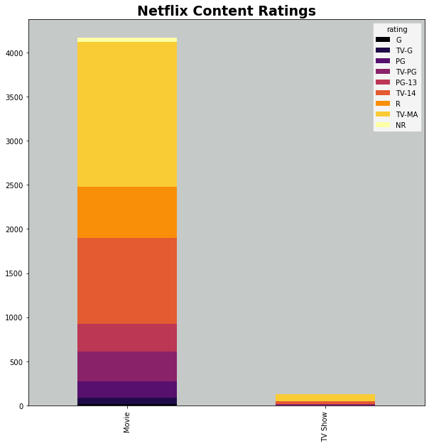
Netflix Content Ratings
Over 50% of Netflix produced movies were rated TV-PG, with the second highest number being TV-MA.
The majority of television shows produced by Netflix were rated TV-MA, with about 25% rated TV-14.

Slide 10
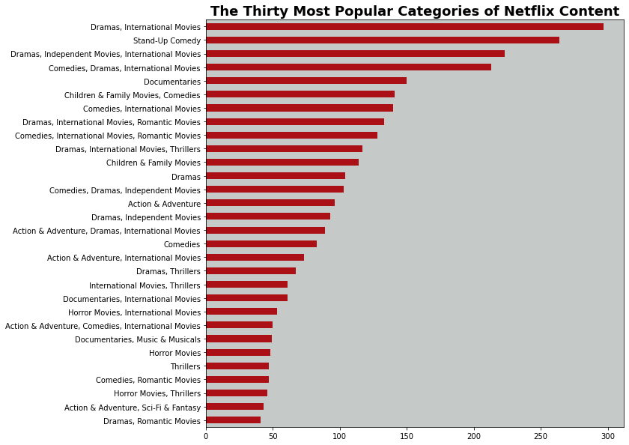
The Thirty Most Popular Categories of Netflix Content
The most popular category of Netflix content was Dramas/International Movies.
The second popular category was stand-up comedy.
Movies that were placed in the Drama/Romantic/International category were more popular by about 100% than movies placed in the Drama/Romantic category.

Slide 11
Conclusions
Netflix, since 2008, has largely focused on producing movies, the majority of which are international dramas and stand-up comedies.
The largest content release spike came in 2017 and 2018 and has sharply dropped off since.
Early analysis indicates that Netflix focuses on content for both young and older audiences.
Future research could look at determining age group demographics, watch times, and returning viewers (those that watch a show or movie again after finishing it).

Slide 12
References
https://translatorswithoutborders.org/language-data-for-india
https://www.kaggle.com/shivamb/netflix-shows
https://www.britannica.com/topic/Netflix-Inc
https://worldclass.regis.edu/d2l/le/content/273433/viewContent/4017190/View

